Slide 1
EECS 445
Project 2 Quickstart
March 10th, 2022

Slide 2
Due:
Wednesday, 3/23 @ 10:00 pm EST
Project 2 Released

Slide 3
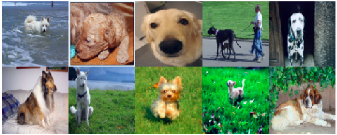
P2 Intro
Problem: Classifying dog breeds from images
Approach: Build a CNN using Pytorch, experiment with Transfer Learning and Data Augmentation

Slide 4
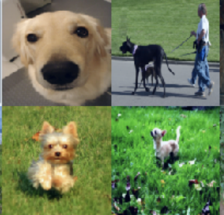
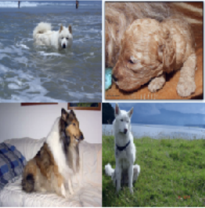
Dataset
12,775 PNG Images
Located in data/images/
Each image: 3 x 64 x 64 (RGB color channels)
10 dog breeds
4 partitions: training, validation, test, held-out
2 tasks (target and source)
metadata found in data/dogs.csv

Slide 5
Training CNNs
You will implement the architecture of the CNN using layer classes in pytorch and the parameter values given in the spec appendix
You will also implement the weight initialization of the layers and forward pass through the network
This defines the order of operations an input datapoint goes through in your model
Note that pytorch automatically handles the backpropagation calculations, you just need to fill in the train_epoch function
Hint: Look at the pytorch documentation examples!
You will also implement early stopping
This is used to prematurely stop training at a certain epoch when you observe validation loss has not decreased for a predetermined number of epochs (called the patience!)

Slide 6

Training CNNs Cont.
The Criterion in the appendix refers to the loss function we use
We use Cross Entropy Loss
The Optimizer in the appendix refers to the tool we use to minimize the loss function
We use the Adam technique which is a form of stochastic gradient descent
True label
Predicted label

Slide 7






Target Architecture
Task: build CNN architecture for target task as specified in Appendix B
Architecture (target.py)
__init__(): construct each layer of the convolutional neural network
init_weights(): initialize parameters (weights + bias) for each layer
forward(x): define forward propagation for a batch of input examples
Model parameters: criterion, optimizer, learning rate, patience, batch size
Torch.nn documentation: https://pytorch.org/docs/stable/nn.html

Slide 8
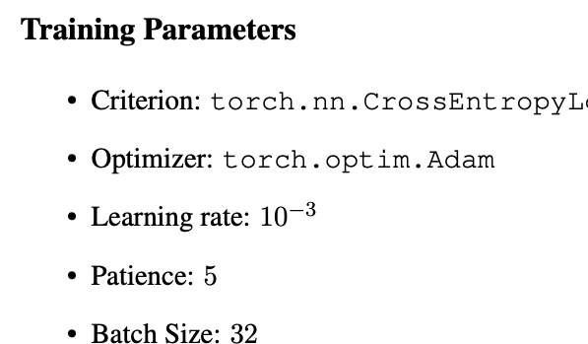
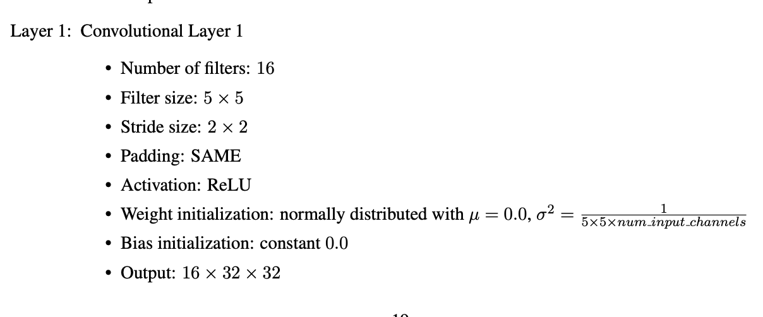
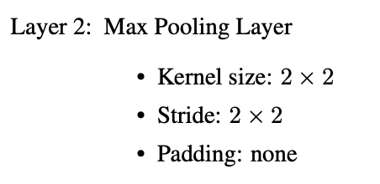
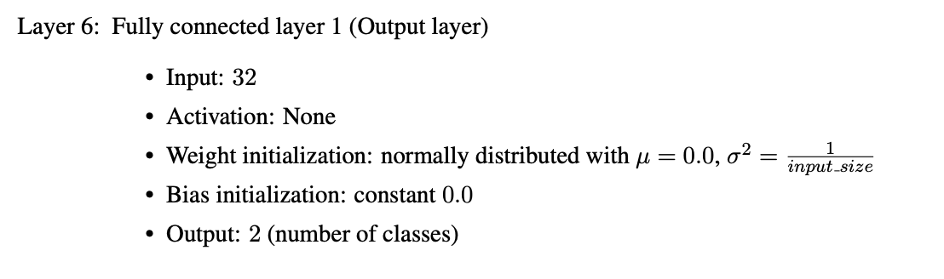
Example Layers

Slide 9
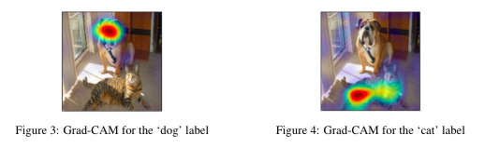
Grad-CAM
Tool to help us visualize which areas of the image contribute the most to each class prediction
You will use this paper to answer the questions for this section
You will manually calculate the activation map produced by this tool for one class label
Intuitively, this means you will find how useful different areas of the image at a particular step are for predicting a certain class label

Slide 10
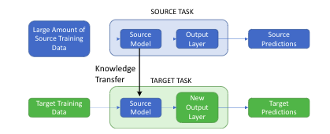
Transfer Learning
Transfer Learning
Sometimes a certain task is related to other classification tasks such that the model parameters learned for one task are informative to the other
We call the task we want to learn the target task and the task we already have a model for the source task
The idea is to use the layers/weights from the source task in the model of the target task in the hopes that similar features will be extracted and used from the input

Slide 11
Transfer Learning Cont.
Recall that the target task is classifying Golden Retrievers and Collies
The source task you will use in this project is classifying 8 different breeds besides Golden Retrievers and Collies
We hypothesize that the features we learn in the source task (i.e. features of different dogs) will be useful in our target task
The concept of freezing layers allows us to control the extent to which we leverage the source task in our training of the target task

Slide 12


Data Augmentation
Data Augmentation
We may also observe that our training data is not entirely representative of the possible inputs to our model
We can introduce new training data by altering the existing training data slightly and adding it to the training set
Alterations include rotating and grayscaling the images in this project
Can you think of more? Try them in the Challenge section!
Rotation
Grayscale

Slide 13
Thank you!

